Slide 1
Chapter 10
Instruction Set Architecture

Slide 2
10-1 Computer architecture concepts
Machine language: binary language
Assembly language: symbolic language
In the past, architecture, organization and hardware are used to descript a computer.
Due to the higher and higher performance of computer, the relationships among architecture, organization and hardware become interwined.
Instruction set architecture (ISA) is then used to encompass the whole of computer.

Slide 3
10-1 Computer architecture concepts
The format of an instruction is divided into groups called fields as follows.
  opcode field
  address field
  mode field
The steps for executing an instruction:
  Fetch the instruction
  Decode the instruction
  Locate the operand
  Fetch the operand (if necessary)
  Execute the operation in processor registers
  Store the results
  Go back to step 1

Slide 4
10-4 Instruction Set Architectures
Reduced Instruction Set Computers (RISCs)
  Simple instruction
  Flexibility
  Higher throughput
  Faster execution
Complex Instruction Set Computers (CISCs)
  Hardware support for high-level language
  Compact program

Slide 5
Properties of RISC and CISC
RISC
  Store/load are the only memory accesses
  Data manipulation instructions are register-to-register
  Simple addressing mode
  Instruction formats are all the same length
  Instructions perform elementary operations
  One instruction per cycle (simple instruction)

Slide 6
Properties of RISC and CISC
CISC
  Memory access is available to most types of instruction
  Many addressing mode (substantial in number)
  Instruction formats are of different lengths
  Instructions perform both elementary and complex operations (microinstructions are then necessary0
  Multiple cycle for executing one instruction (complex instruction)

Slide 7
RISC and CISC
Actual instruction set architecture range between those which are purely RISC and those are purely CISC.
There is a basic set of elementary operations that most computers include among their instruction.
This chapter will focus on the elementary instructions that are included in both RISC and CISC
  Data transfer instructions
  Data manipulation instruction
  Program-control instructions

Slide 8
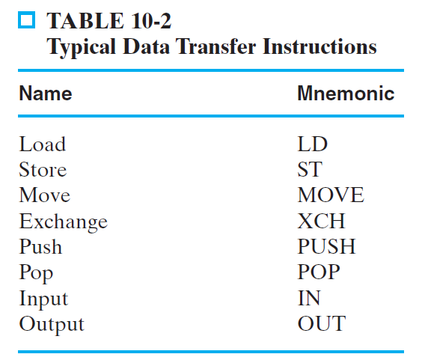
10-5 Data-transfer instructions

Slide 9
10-6 Data-manipulation instructions
Arithmetic instructions
Logical and bit-manipulation instructions
Shift instruction

Slide 10
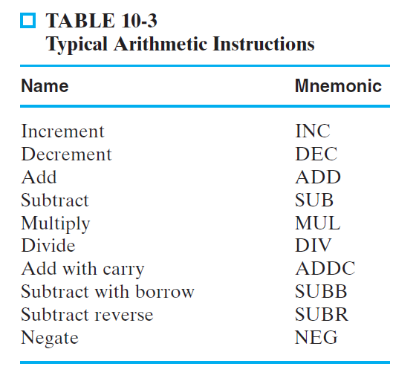
Arithmetic instructions

Slide 11
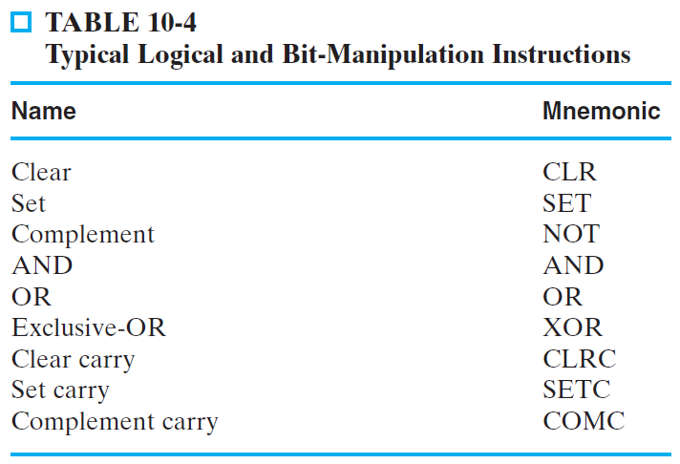
Logical and bit-manipulation instructions

Slide 12
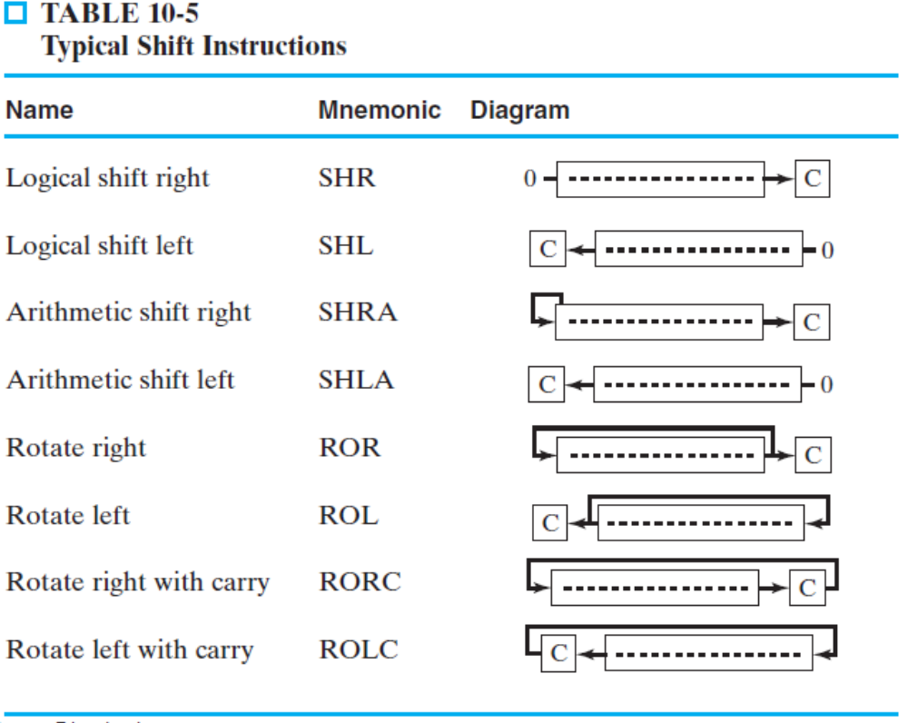
Shift instruction

